Slide 1
Parent Meeting
Phonics Screening Check
Notes:
Approximately 10 minutes is needed for this session.
Notes are provided to help you lead the presentation.
Notes in italics are for your attention only.
Provide copies of ‘Reading at Home Booklet 2’ from Oxford Owl for each parent.

Slide 2
What is the Phonics Screening Check?
A national word-reading check at the end of Year 1.
Children read 40 words.
This will be carried out during a week in June.
Notes:
Children complete the phonics screening check at the end of Year 1 so that parents can be confident their children are being taught to read successfully.
Children read 40 words. It takes between two and five minutes.
If they do not manage to read 32 of the words successfully, they are given extra support, and repeat the check at the end of Year 2.
It means that all children will be able to read accurately before they begin Year 3.

Slide 3
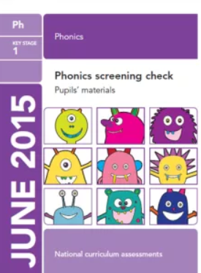
What is the Phonics Screening Check?
The aim is to confirm whether individual children have learnt sufficient phonic decoding and blending skills to an appropriate standard set by the government.
Notes:
Children complete the phonics screening check at the end of Year 1 so that parents can be confident their children are being taught to read successfully.
Children read 40 words. It takes between two and five minutes.
If they do not manage to read 32 of the words successfully, they are given extra support, and repeat the check at the end of Year 2.
It means that all children will be able to read accurately before they begin Year 3.

Slide 4
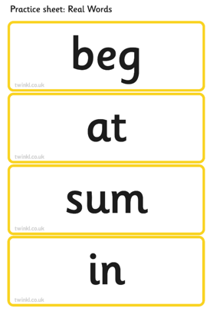
What happens during the check?
The children will complete the check one at a time with their class teacher.
The check takes 5 to 10 minutes.
The test contains 40 words-
20 real words…

Slide 5
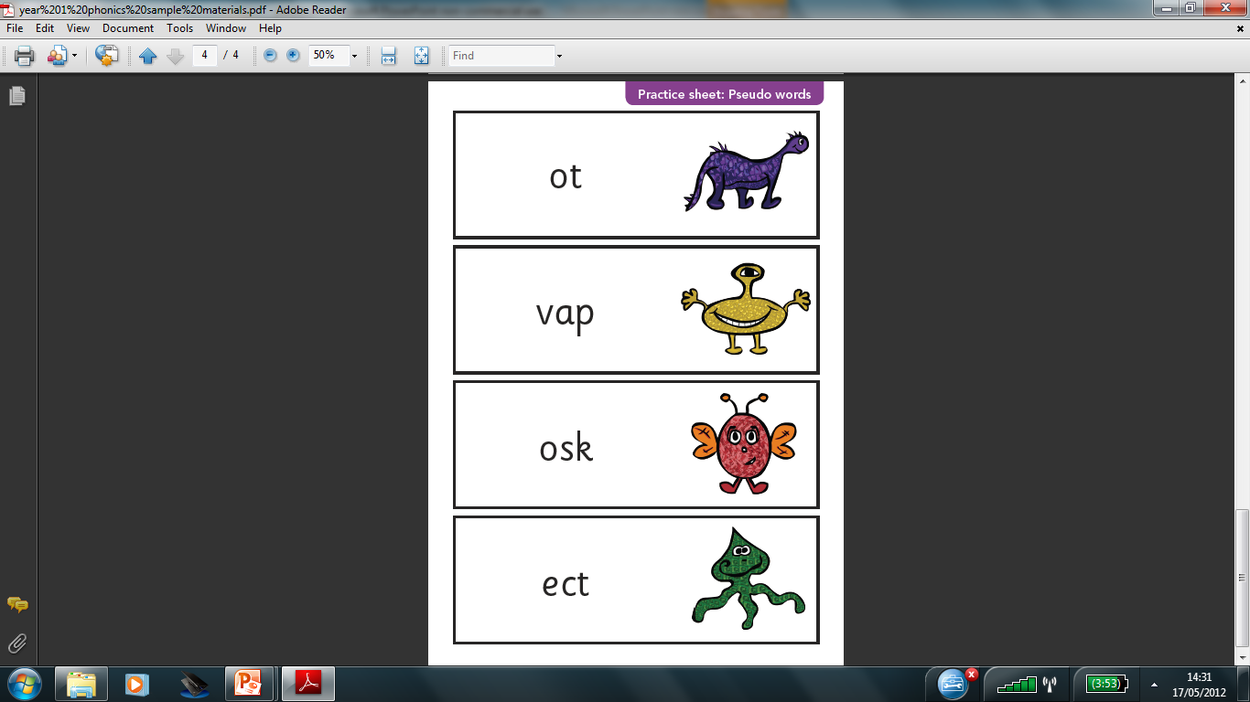
What happens during the check?
…and 20 pseudo (alien/nonsense)words.
These will be new to all pupils.
They do not favour children
with a good vocabulary or good
visual memory of words.

Slide 6
What happens if my child does not pass?
The Phonics Screening Check will be completed again in Year 2.
Your child will continue to have extra practice and support in class.

Slide 7
How to help your child.
Practise reading sounds speedily.
Help your child to use ‘Special Friends’, ‘Fred Talk’ to read words.
Look out for the RWI Virtual Classroom links on the newsletter.
Listen to your child read their Storybook(s) every day.
Talk to us if you have questions or concerns.
Notes:
Help your child to use ‘Special Friends’, ‘Fred Talk’ to read words.
Practise reading sounds speedily.
Watch the Virtual Classroom films together.
Listen to your child read their Storybook every day.

Slide 8

Any questions?

