Slide 1


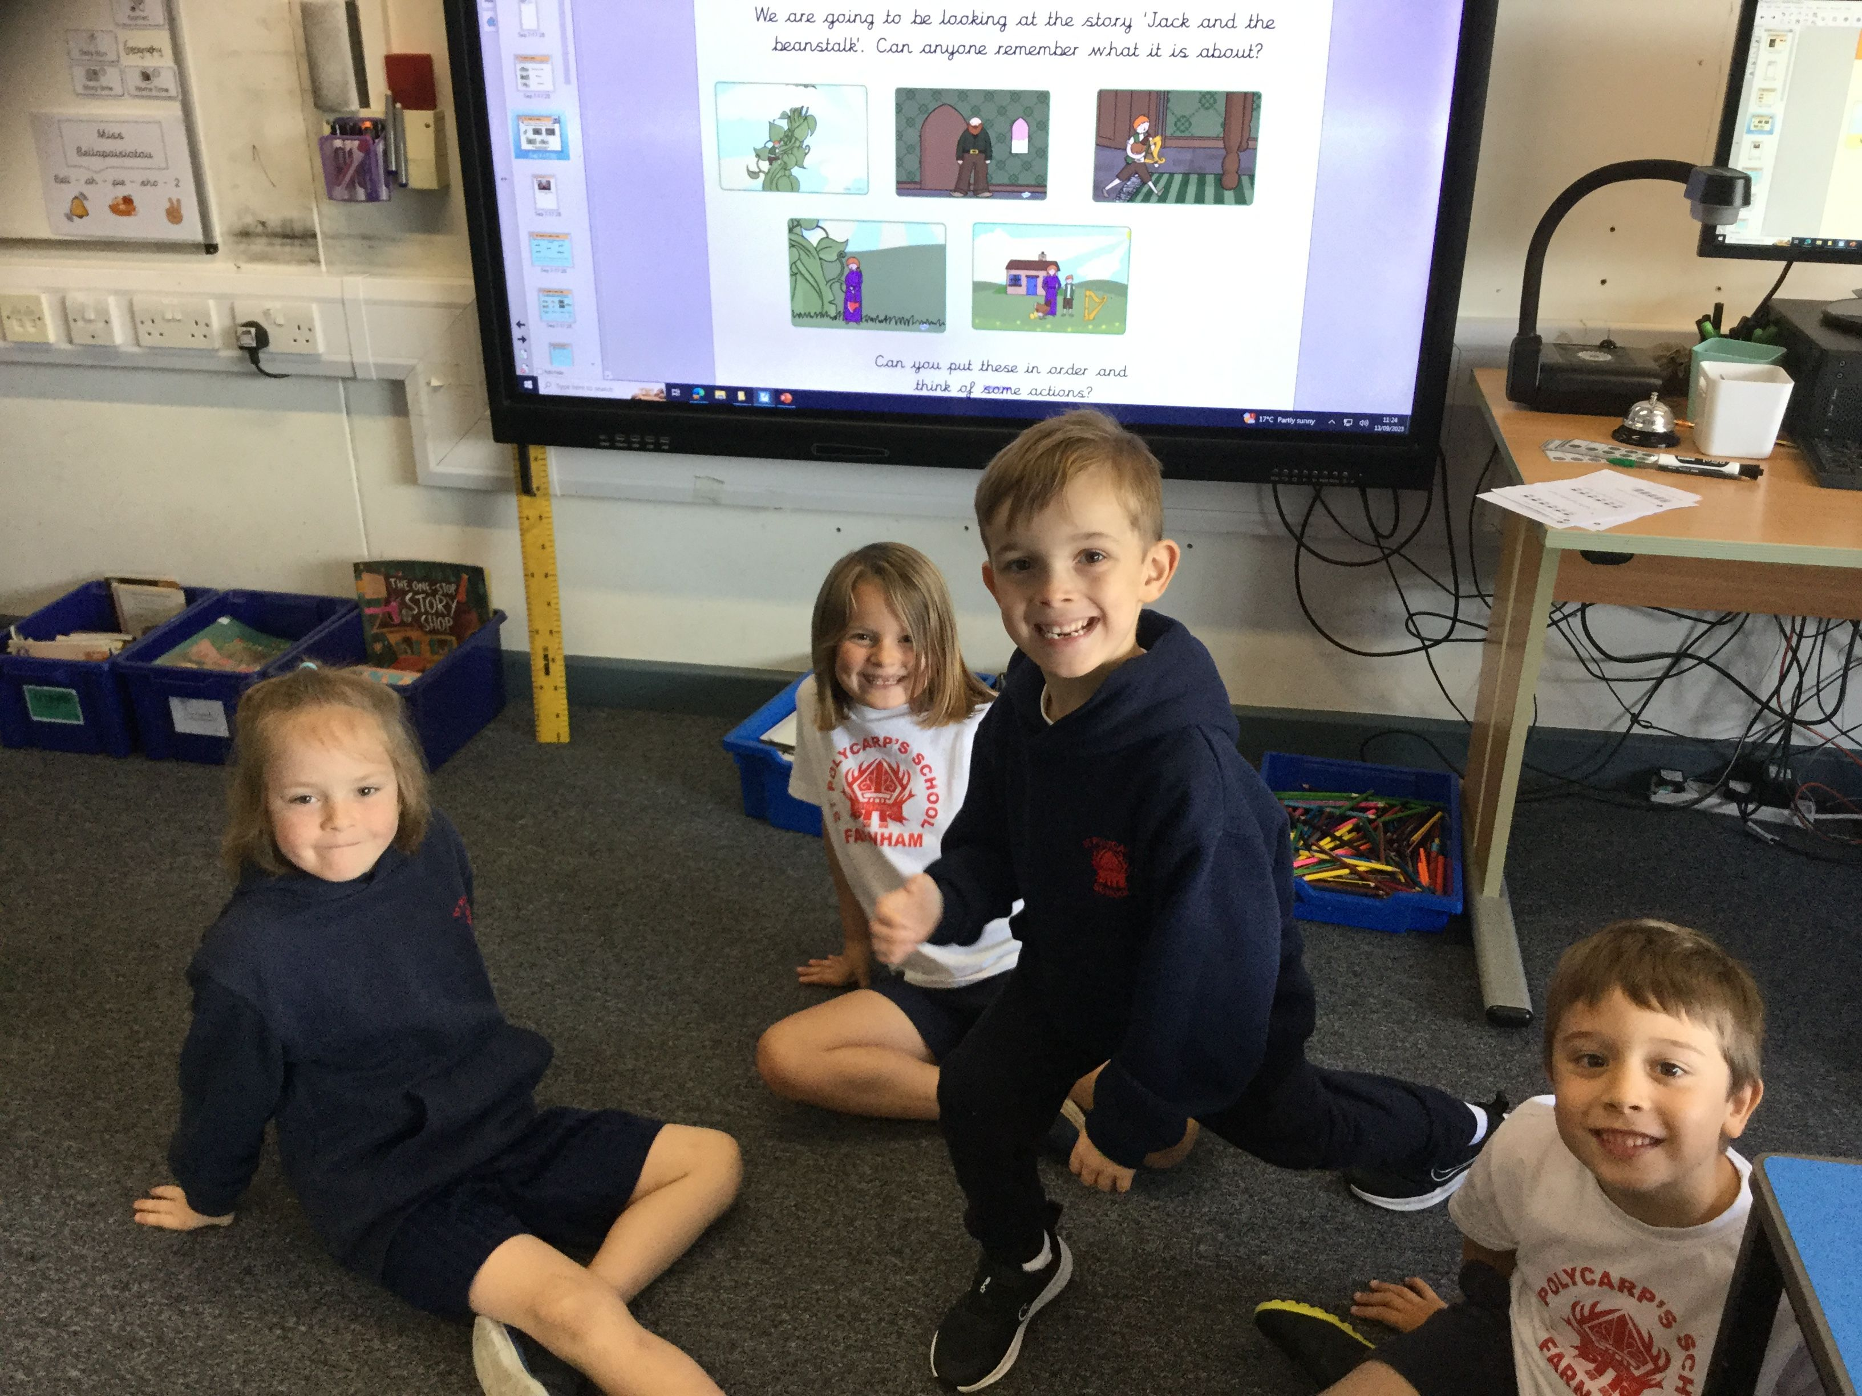
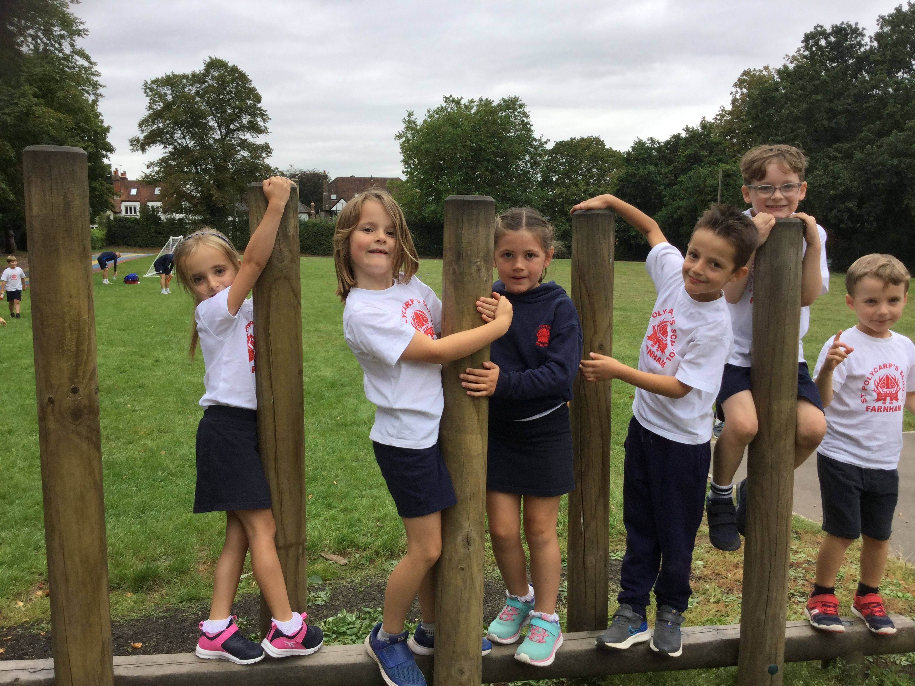
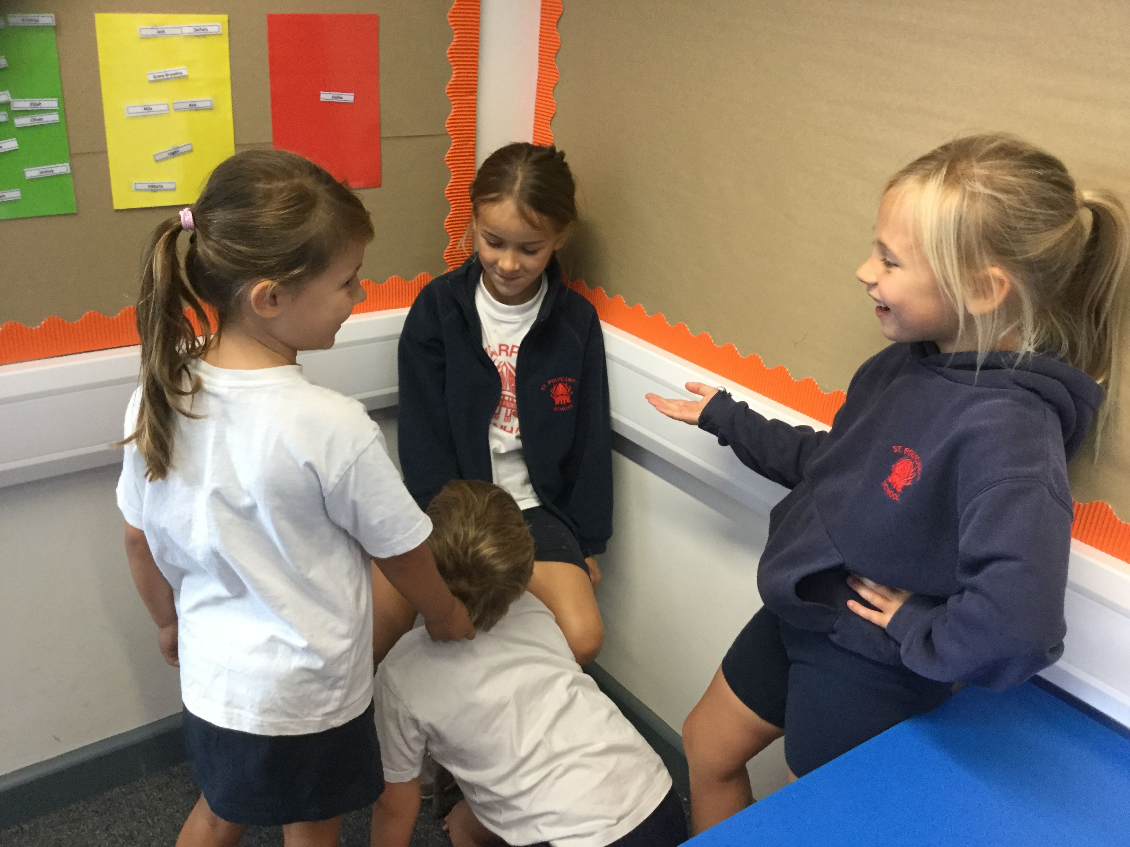
Welcome to Year 2
Parent information session

Slide 2
Introductions
Mrs Gray teaches Swallows class.
Miss Bellapaisiotou teaches Swift class
We currently have a shared teaching assistant called Mrs Cochrane

Slide 3
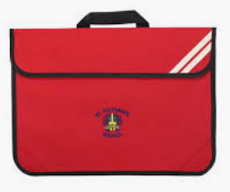
What is needed:
Children must bring a water bottle, their book bag and a coat to school.
Reading books and journals must also be returned daily
Children must come to school in their PE kit on games days - Wednesday
P.E lessons will happen on....
Swallows- Monday AM
Swifts - Tuesday AM
On this day, your child will need to bring their PE kit to school in their bag as we are changing at school for this session.

Slide 4
Trips for the year
There are 3 trips planned for the year...
1x local and of no cost (Alice Holt)
1x local with a small charge (Farnham Museum)
1x Trip further afield (Arundel Castle)
This gives us a great opportunity to further explore our local area, and also strengthen our curriculum offerings.
We always need adult helpers, so please do reach out if you think you can support us on any of these trips.

Slide 5





Reading is the key!
Children will continue reading books from our new reading scheme: Read Write Inc. Their books will get changed every three school days. These books should be read and discussed daily.
We will assess their reading each term. We also encourage sharing stories as a family.

Slide 6
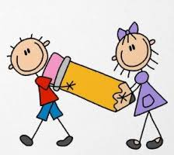
Writing
Children need to form letters in print correctly
We expect that children use full stops, capital letters and finger spaces with fluency.
We also challenge them to use others forms of punctuation
We focus on expanding vocabulary and sentence structure including adjectives, conjunctions and adverbs
Focussing upon editing in Summer term

Slide 7
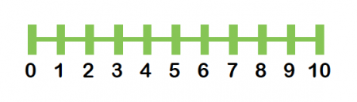
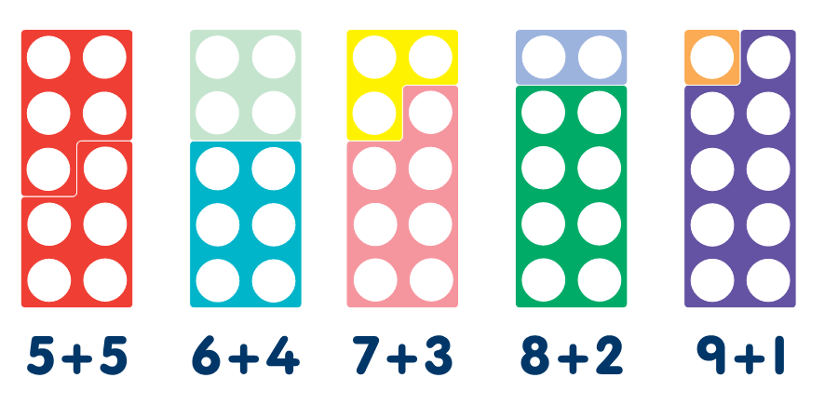
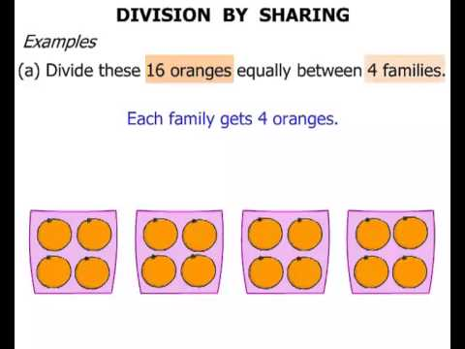
Maths
Place value needs to be secure
Basic counting forwards and backwards up to 100
Master number bonds to 10 and 20
Be able to count in 2s, 5s, 10s then 3s
Expose children to telling the time
Methods taught - number lines, partitioning, grouping
Mathletics - used in class and as homework

Slide 8
Maths
Mastery to 10 is really important so encouraging children to experiment with a variety of a different number sentences that don't breach 20 is really important
  e.g. 6 + 4 = 10
  With understanding of place value children will then be able to do 60 + 40 = 100.
  Please find opportunities to drip feed maths through everyday life :
    Telling the time to the hour
    Reading numbers on houses
    Buying things using change

Slide 9
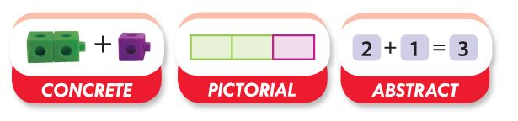
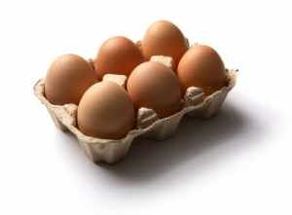
Maths Mastery Approach
Can you show me in a visual way?
Concrete - Pictorial - Abstract
Fluency - Reasoning - Problem-solving
2 x 3 = 6
2 x __ = 6
How can 6 eggs be arranged in a box?
Please do not forget the importance of reasoning style questions!

Slide 10
Homework
Mathletics and Spellings will be set on a Friday.
These are all online activities and the logins can be found in the cover of your childs reading record.
Spelling quizzes will be on a Thursday
It is also an expectation that a child reads every day

Slide 11
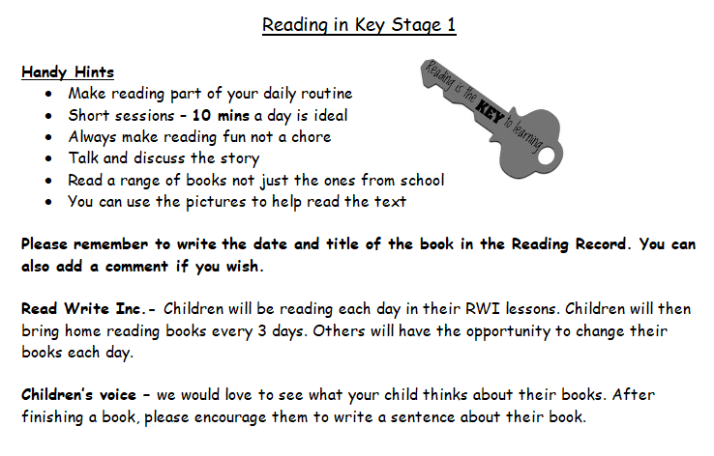

Slide 12


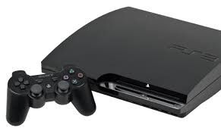

E-safety
We teach e-safety explicitly and implicitly.
We ask you to think about:
age-appropriate apps - please monitor
parental controls on phones, IPad, computers, laptops, play stations…
children being with an adult/in view when using devices
children should not use their name, address, phone number or any personal details on any websites
children should not be identifiable (i.e. uniform, photos etc).

Slide 13
Any Questions?
Remember you can approach us at hand over at the end of the day if you have any questions. We are looking forward to a fantastic year!

